Slide 1

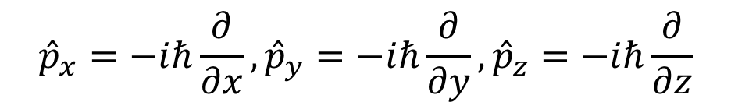

In Classical Mechanics,
$$L=r×p=\left|\begin{matrix}e_{x} & e_{y} & e_{z} \\ x & y & z \\ p_{x} & p_{y} & p_{z}\end{matrix}\right|=e_{x}\left(yp_{z}−zp_{y}\right)+e_{y}\left(zp_{x}−xp_{z}\right)+e_{z}\left(xp_{y}−yp_{x}\right)$$
$$=L_{x}e_{x}+L_{y}e_{y}+L_{z}e_{z}$$
In Quantum Mechanics,
$${\hat{p}}_{x}=−iℏ\frac{∂}{∂x},{\hat{p}}_{y}=−iℏ\frac{∂}{∂y},{\hat{p}}_{z}=−iℏ\frac{∂}{∂z}$$
$$\hat{L}=r×\hat{p}=\left|\begin{matrix}e_{x} & e_{y} & e_{z} \\ x & y & z \\ p_{x} & p_{y} & p_{z}\end{matrix}\right|=e_{x}\left(y{\hat{p}}_{z}−z{\hat{p}}_{y}\right)+e_{y}\left(z{\hat{p}}_{x}−x{\hat{p}}_{z}\right)+e_{z}\left(x{\hat{p}}_{y}−y{\hat{p}}_{x}\right)$$
$$={\hat{L}}_{x}e_{x}+{\hat{L}}_{y}e_{y}+{\hat{L}}_{z}e_{z}$$

Slide 2

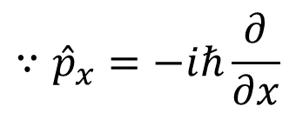

$$\left[\hat{x},{\hat{p}}_{x}\right]ψ=\hat{x}{\hat{p}}_{x}ψ−{\hat{p}}_{x}\hat{x}ψ=\hat{x}{\hat{p}}_{x}ψ−{\hat{p}}_{x}xψ=\hat{x}p_{x}ψ−{\hat{p}}_{x}xψ$$
$$\hat{x}p_{x}ψ=p_{x}\hat{x}ψ=p_{x}xψ$$
$${\hat{p}}_{x}xψ=\left({\hat{p}}_{x}x\right)ψ+x\left({\hat{p}}_{x}ψ\right)=−iℏψ+xp_{x}ψ$$
$$∵{\hat{p}}_{x}=−iℏ\frac{∂}{∂x}$$
$$\left[\hat{x},{\hat{p}}_{x}\right]ψ=iℏψ$$
$$Likewise, \left[\hat{y},{\hat{p}}_{y}\right]ψ=iℏψ and \left[\hat{z},{\hat{p}}_{z}\right]ψ=iℏψ$$

Slide 3



$$\left[{\hat{L}}_{x},{\hat{L}}_{y}\right]ψ={\hat{L}}_{x}{\hat{L}}_{y}ψ−{\hat{L}}_{y}{\hat{L}}_{x}ψ=\left(y{\hat{p}}_{z}−z{\hat{p}}_{y}\right)\left(z{\hat{p}}_{x}−x{\hat{p}}_{z}\right)ψ−\left(z{\hat{p}}_{x}−x{\hat{p}}_{z}\right)\left(y{\hat{p}}_{z}−z{\hat{p}}_{y}\right)ψ$$
$$\left(y{\hat{p}}_{z}−z{\hat{p}}_{y}\right)\left(z{\hat{p}}_{x}−x{\hat{p}}_{z}\right)ψ=\left(y{\hat{p}}_{z}z{\hat{p}}_{x}−y{\hat{p}}_{z}x{\hat{p}}_{z}−z{\hat{p}}_{y}z{\hat{p}}_{x}+z{\hat{p}}_{y}x{\hat{p}}_{z}\right)ψ$$
$$\left(z{\hat{p}}_{x}−x{\hat{p}}_{z}\right)\left(y{\hat{p}}_{z}−z{\hat{p}}_{y}\right)ψ=\left(z{\hat{p}}_{x}y{\hat{p}}_{z}−z{\hat{p}}_{x}z{\hat{p}}_{y}−x{\hat{p}}_{z}y{\hat{p}}_{z}+x{\hat{p}}_{z}z{\hat{p}}_{y}\right)ψ$$
$$\left[{\hat{L}}_{x},{\hat{L}}_{y}\right]ψ=\left(y{\hat{p}}_{z}z{\hat{p}}_{x}+z{\hat{p}}_{y}x{\hat{p}}_{z}−z{\hat{p}}_{x}y{\hat{p}}_{z}−x{\hat{p}}_{z}z{\hat{p}}_{y}\right)ψ$$
$$=\left(y{\hat{p}}_{x}\left[{\hat{p}}_{z},z\right]+x{\hat{p}}_{y}\left[z,{\hat{p}}_{z}\right]\right)ψ$$
$$=iℏ\left(x{\hat{p}}_{y}−y{\hat{p}}_{x}\right)ψ=iℏ{\hat{L}}_{z}ψ$$
$$Likewise, \left[{\hat{L}}_{y},{\hat{L}}_{z}\right]ψ=iℏ{\hat{L}}_{x}ψ and \left[{\hat{L}}_{z},{\hat{L}}_{x}\right]ψ=iℏ{\hat{L}}_{y}ψ$$
$$\left(∵Cyclic permutation\right)$$

Slide 4



$$\left[{\hat{L}}_{z},{\hat{L}}_{±}\right]ψ=\left[{\hat{L}}_{z},{\hat{L}}_{x}\right]ψ±i\left[{\hat{L}}_{z},{\hat{L}}_{y}\right]ψ$$
$$=\left[{\hat{L}}_{z},{\hat{L}}_{x}\right]ψ∓i\left[{\hat{L}}_{y},{\hat{L}}_{z}\right]ψ$$
$$=iℏ{\hat{L}}_{y}ψ±{\hat{L}}_{x}ψ$$
$$=±ℏ\left({\hat{L}}_{x}±i{\hat{L}}_{y}\right)ψ=±ℏ{\hat{L}}_{±}ψ$$

Slide 5


$${\hat{L}}^{2}={{\hat{L}}_{x}}^{2}+{{\hat{L}}_{y}}^{2}+{{\hat{L}}_{z}}^{2}$$
$$\left[{\hat{L}}^{2},{\hat{L}}_{z}\right]ψ=\left[{{\hat{L}}_{x}}^{2},{\hat{L}}_{z}\right]ψ+\left[{{\hat{L}}_{y}}^{2},{\hat{L}}_{z}\right]ψ+\left[{{\hat{L}}_{z}}^{2},{\hat{L}}_{z}\right]ψ$$
$$\left[{{\hat{L}}_{x}}^{2},{\hat{L}}_{z}\right]ψ={\hat{L}}_{x}\left[{\hat{L}}_{x},{\hat{L}}_{z}\right]ψ+\left[{\hat{L}}_{x},{\hat{L}}_{z}\right]{\hat{L}}_{x}ψ=−iℏ\left({\hat{L}}_{x}{\hat{L}}_{y}ψ+{\hat{L}}_{y}{\hat{L}}_{x}ψ\right)$$
$$\left[{{\hat{L}}_{y}}^{2},{\hat{L}}_{z}\right]ψ={\hat{L}}_{y}\left[{\hat{L}}_{y},{\hat{L}}_{z}\right]ψ+\left[{\hat{L}}_{y},{\hat{L}}_{z}\right]{\hat{L}}_{y}ψ=iℏ\left({\hat{L}}_{y}{\hat{L}}_{x}ψ+{\hat{L}}_{x}{\hat{L}}_{y}ψ\right)$$
$$\left[{{\hat{L}}_{z}}^{2},{\hat{L}}_{z}\right]ψ=0$$
$$\left[{\hat{L}}^{2},{\hat{L}}_{z}\right]ψ=−iℏ\left({\hat{L}}_{x}{\hat{L}}_{y}ψ+{\hat{L}}_{y}{\hat{L}}_{x}ψ\right)+iℏ\left({\hat{L}}_{y}{\hat{L}}_{x}ψ+{\hat{L}}_{x}{\hat{L}}_{y}ψ\right)=0$$

Slide 6
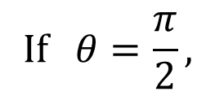






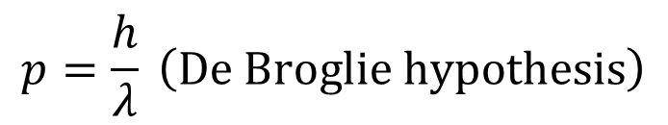

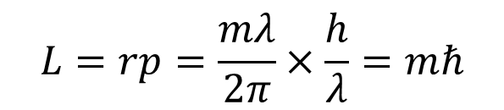
$$L=r×p$$
$$p$$
$$L=\sqrt{{\left|L\right|}^{2}}=rp\sin{θ}$$
$$θ$$
$$r$$
$$If θ=\frac{π}{2},$$
$$L=rp$$
$$p=\frac{h}{λ} \left(De Broglie hypothesis\right)$$
$$L=rp=\frac{mλ}{2π}×\frac{h}{λ}=mℏ$$
$$2πr=mλ \left(Particle on a Ring\right)$$

